Slide 1


ucb bootcamp Project 3 -Team2 Dubai march 25, 2021

Slide 2

User story
Design and create a simple intuitive application
that can be used chat, interact or get to know people in your community.

Slide 3
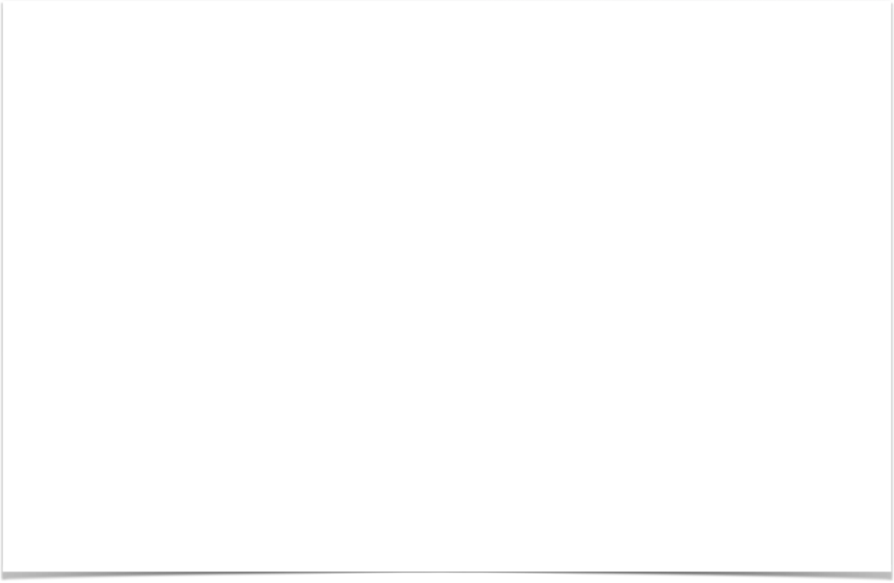
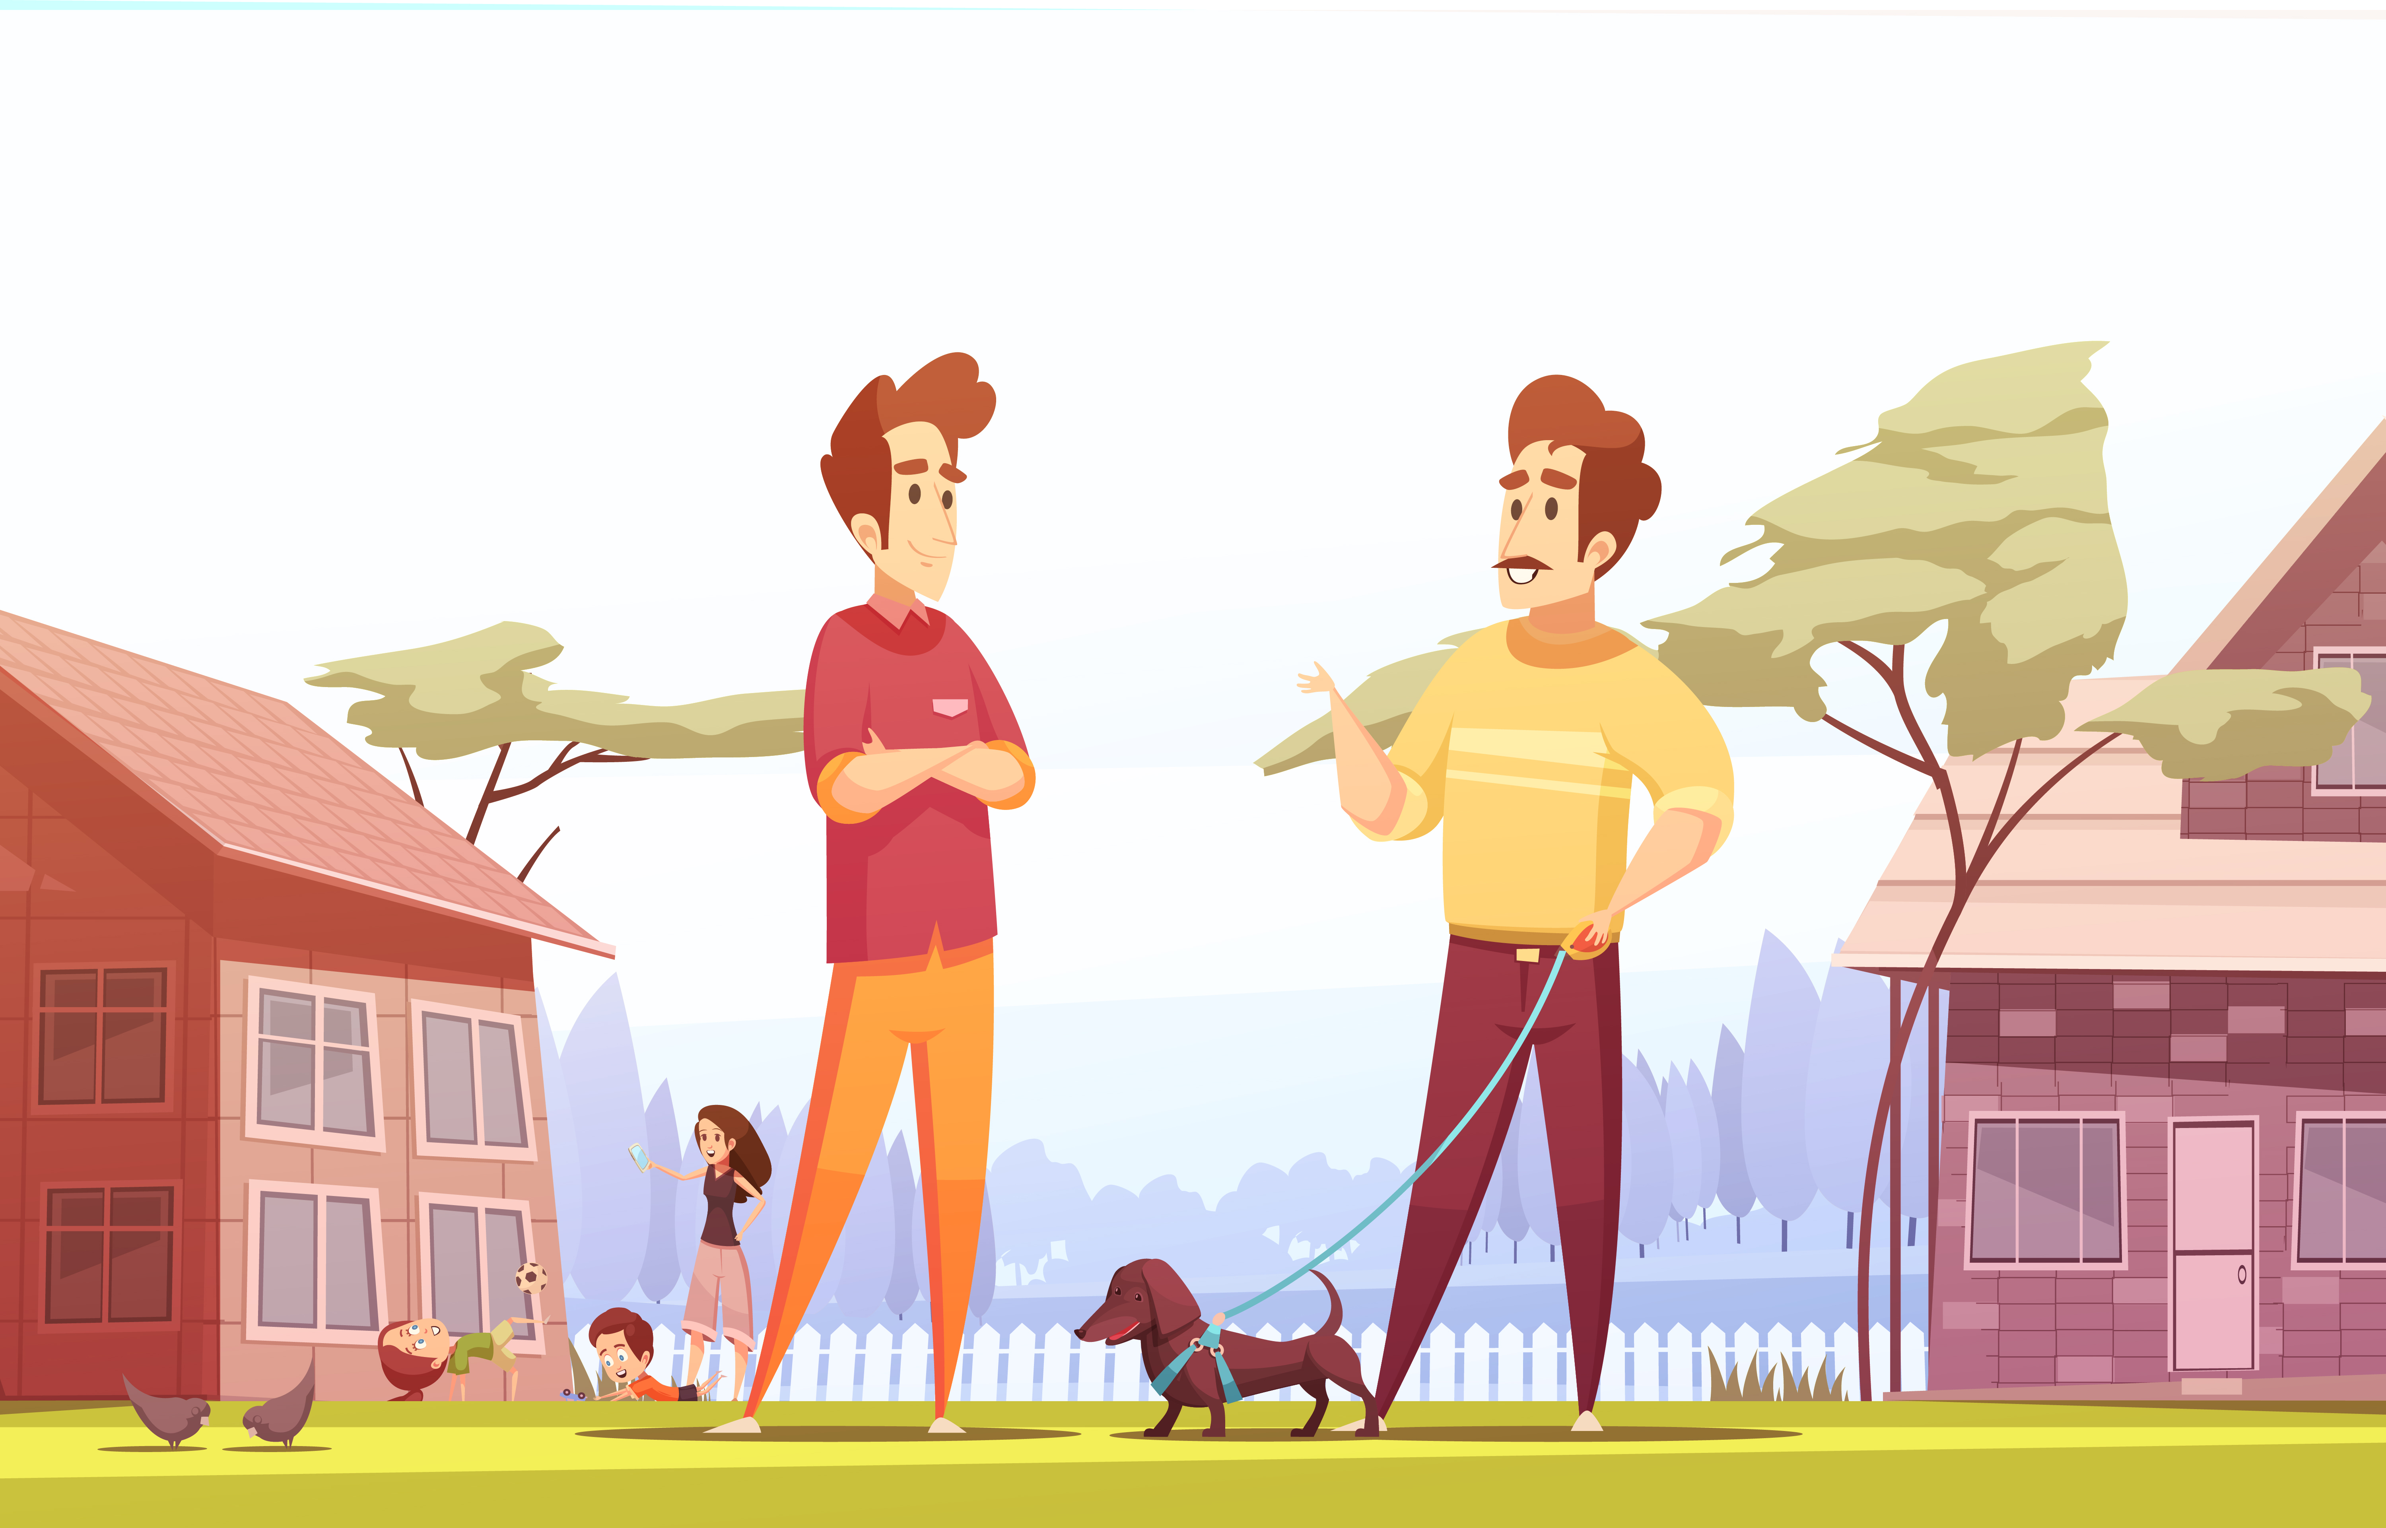

Slide 4
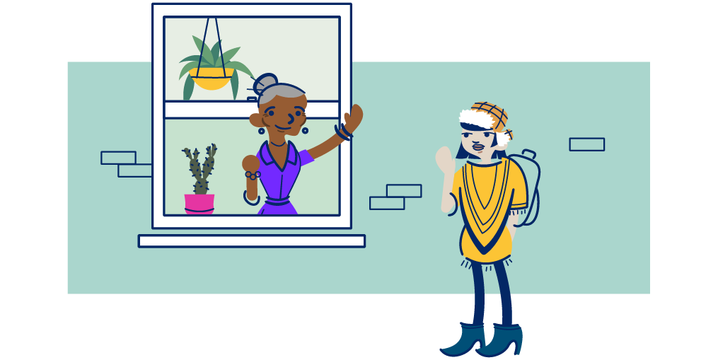
Project overview

Slide 5
Agenda topic
Divide into groups
Begin researching MERN Outline project ideas
Submit Project Proposal for Approval
Initial Design work

Slide 6
Team2 -dubai

Slide 7
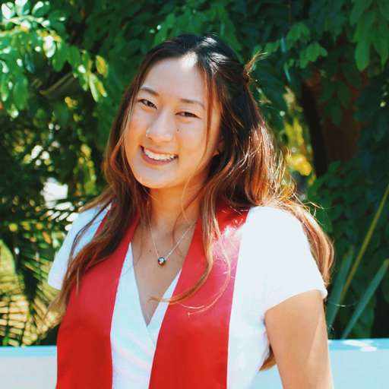


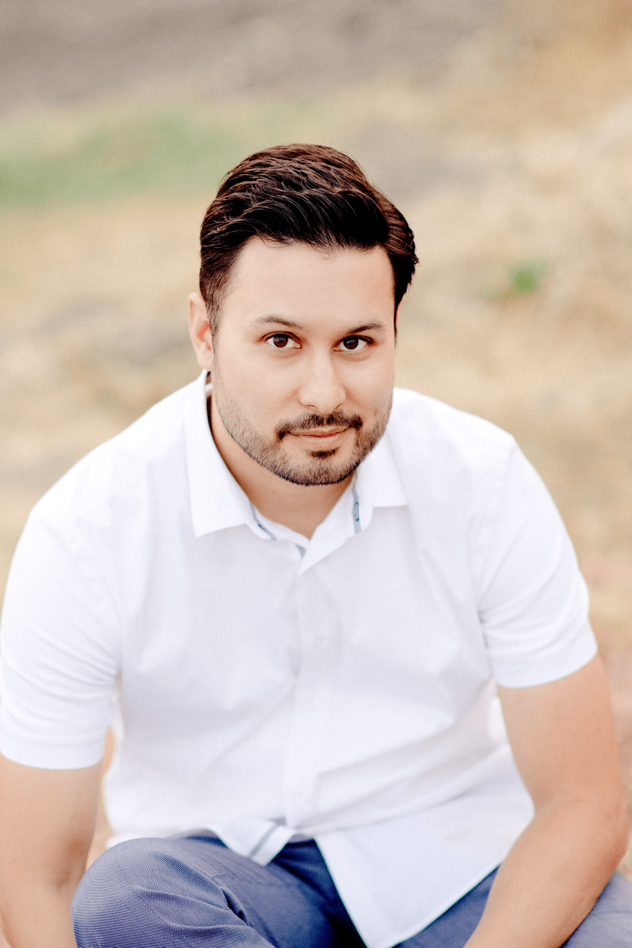

Front ui lead
Delivery lead
Development lead
Design lead
Product lead
Kayla
Muraoka
Jason
Richards
Geoffrey
jiang
Christian
Suchoski
Clinton
chunga

Slide 8

Collaboration time
Brainstorm possible ideas
Begin API Research
Create an initial draft / sketch of the final design
Create a short 1 page proposal listing out each of the following:
Project Title
New Team Name (Team2 -Dubai)
Team Members
Project Description
Sketch of Final Product
APIs to be React project
Rough Breakdown of Tasks

Slide 9
Tools

Slide 10
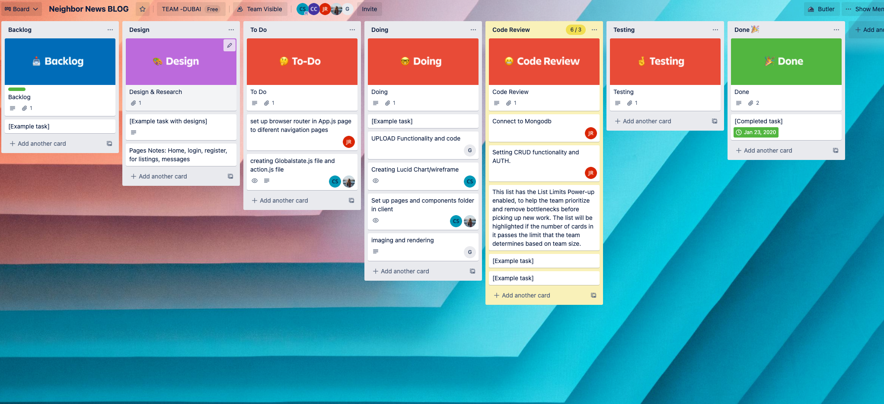
Trello
Trello is a great project management tool for creating to-do lists and communicating updates.

Slide 11
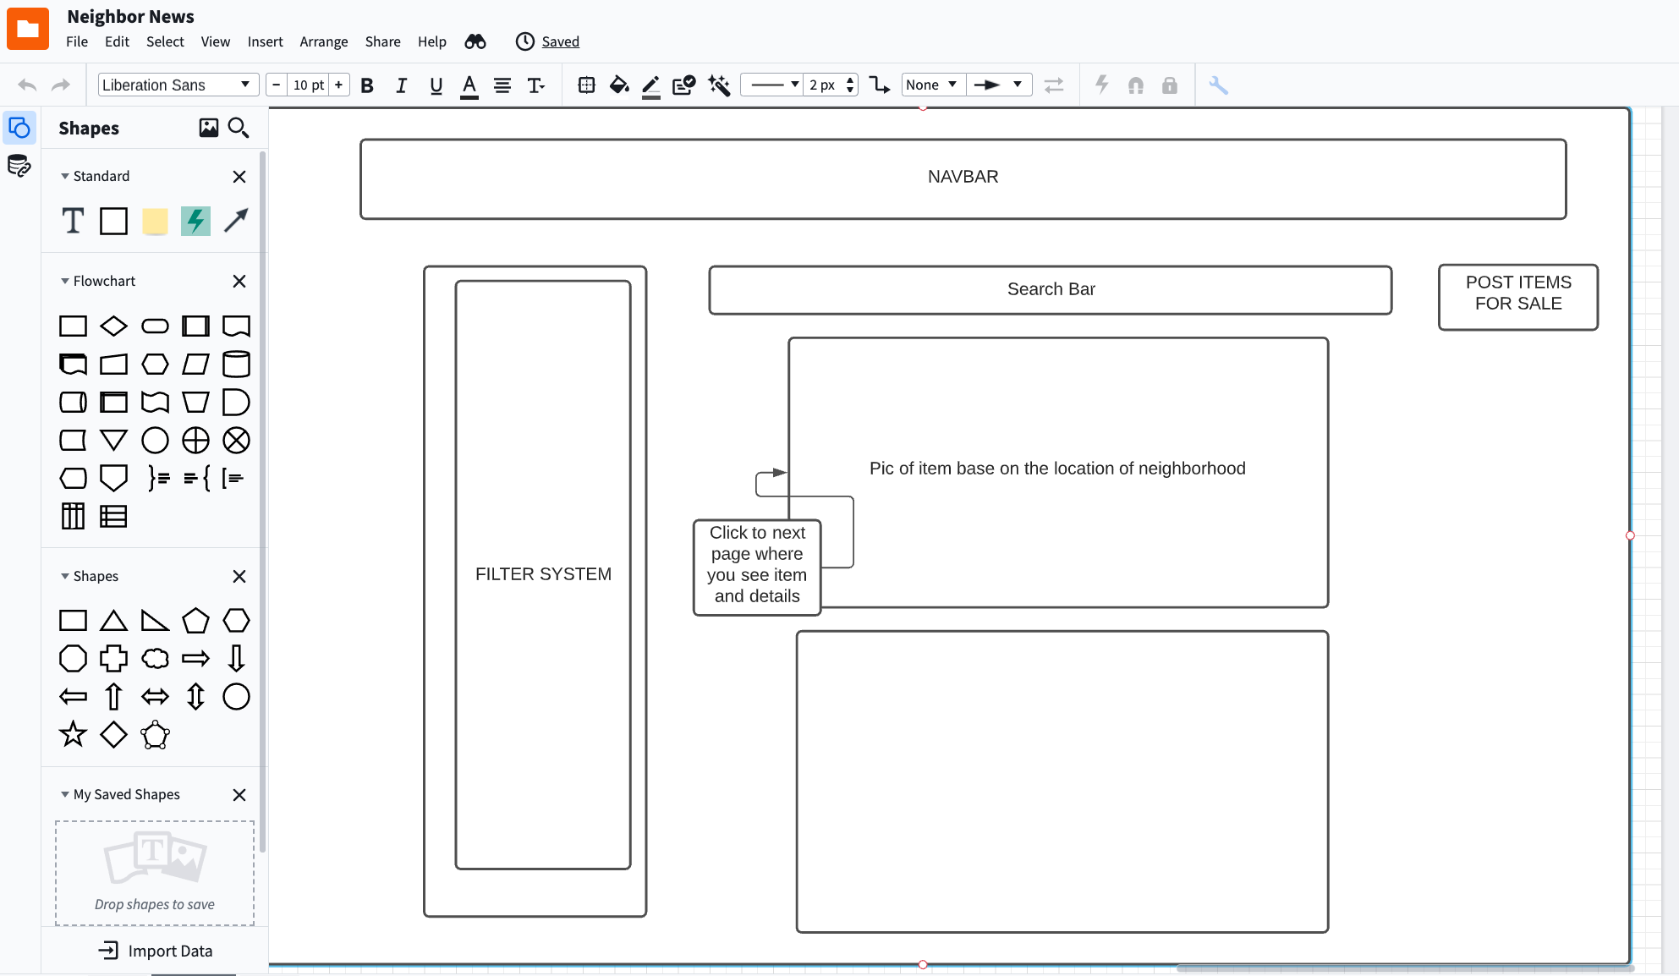
Lucid chart
- Create professional flowcharts, process maps, UML models.orgcharts, and er diagrams…

Slide 12
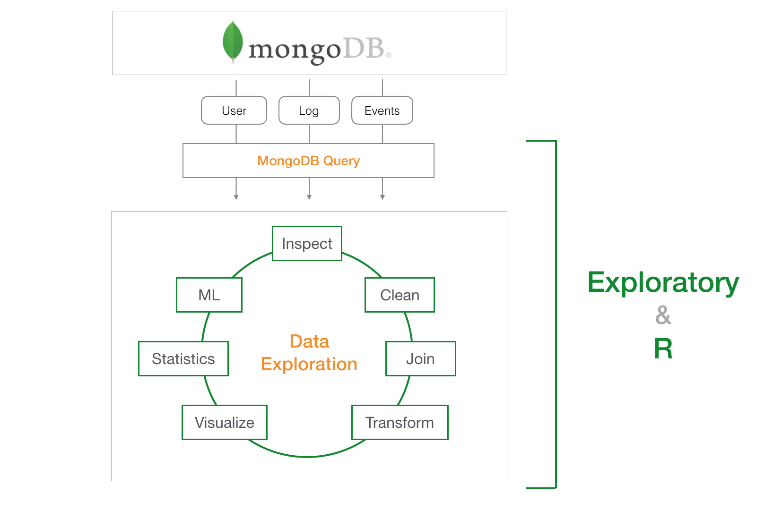
mongoBD
Mongodb is a source-available cross-platform document-oriented database program

Slide 13
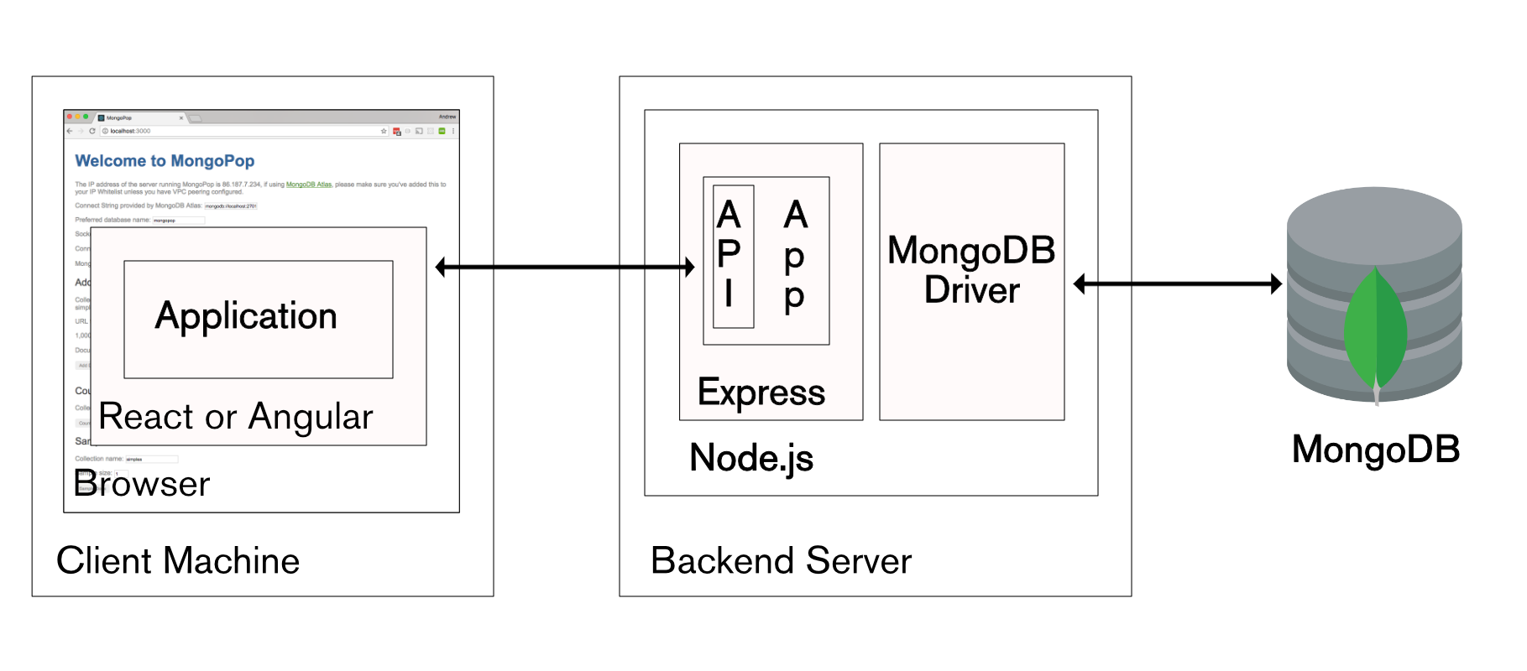
mongoBD
- Classified as a nodal database program , mongodb uses json-like documents with optional schemas

Slide 14
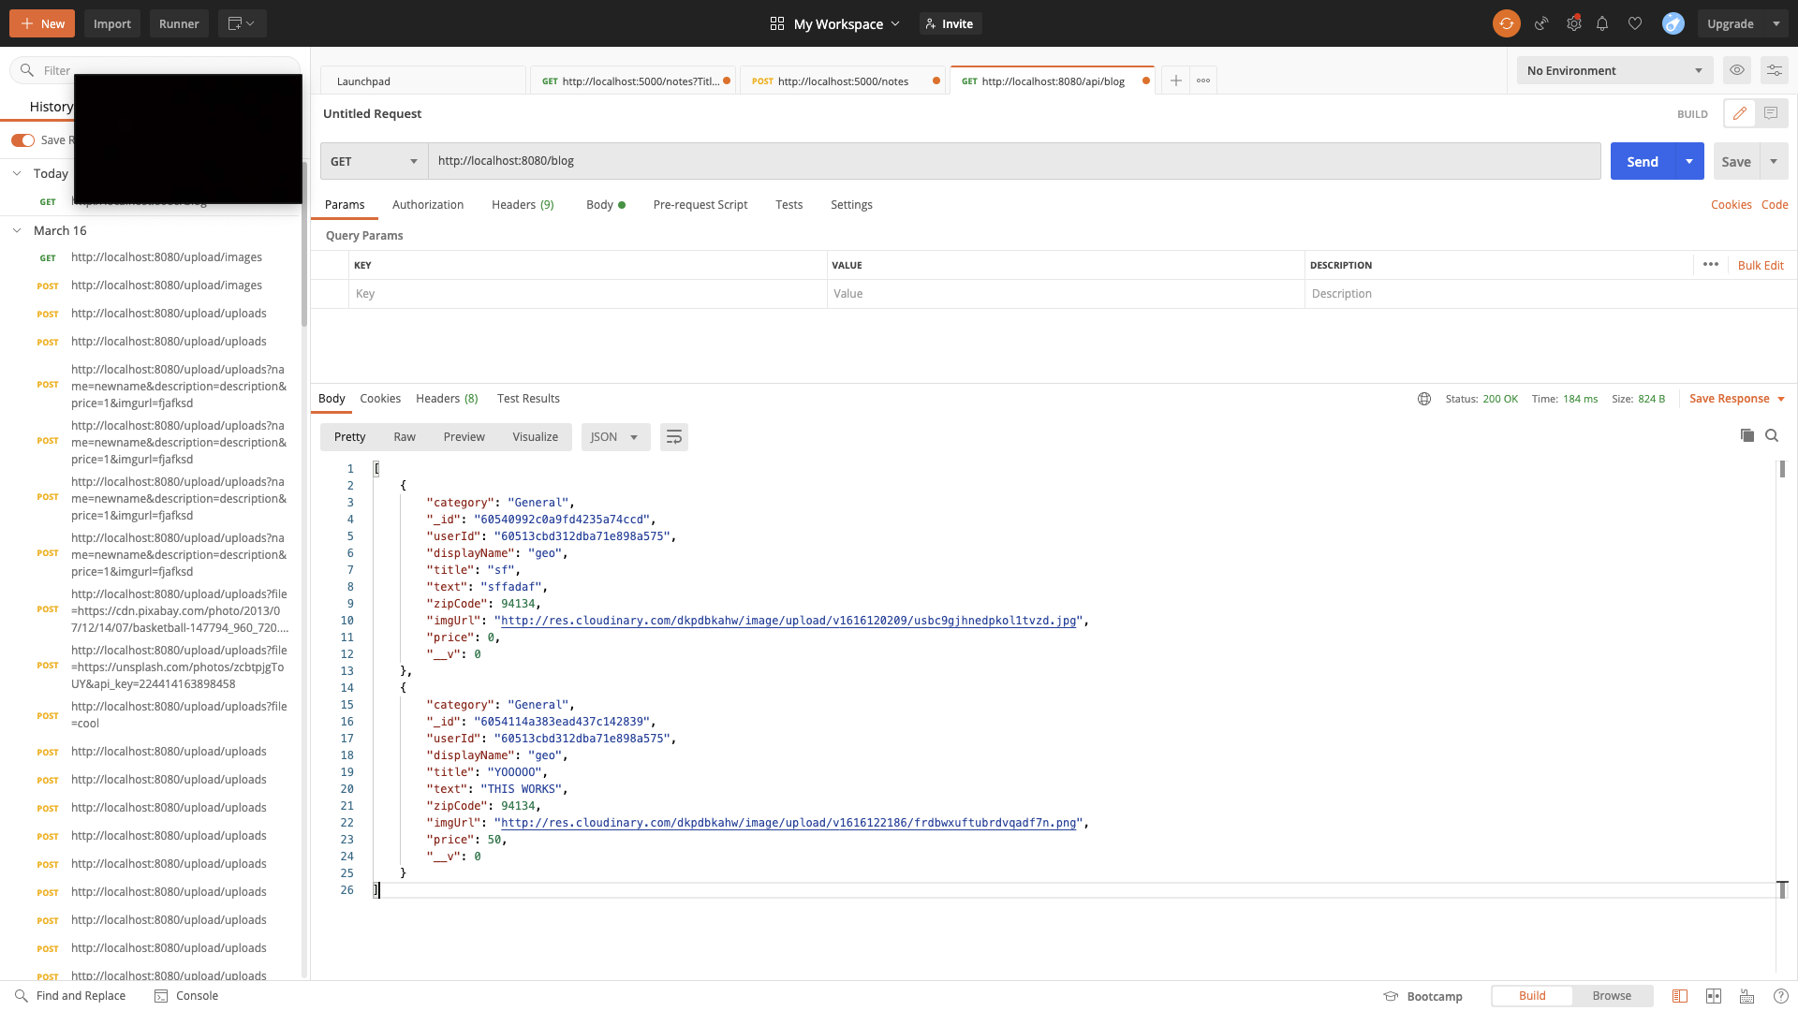
Postman
Simplify each step of building an API and streamline collaboration so you can create better APIs—faster.

Slide 15
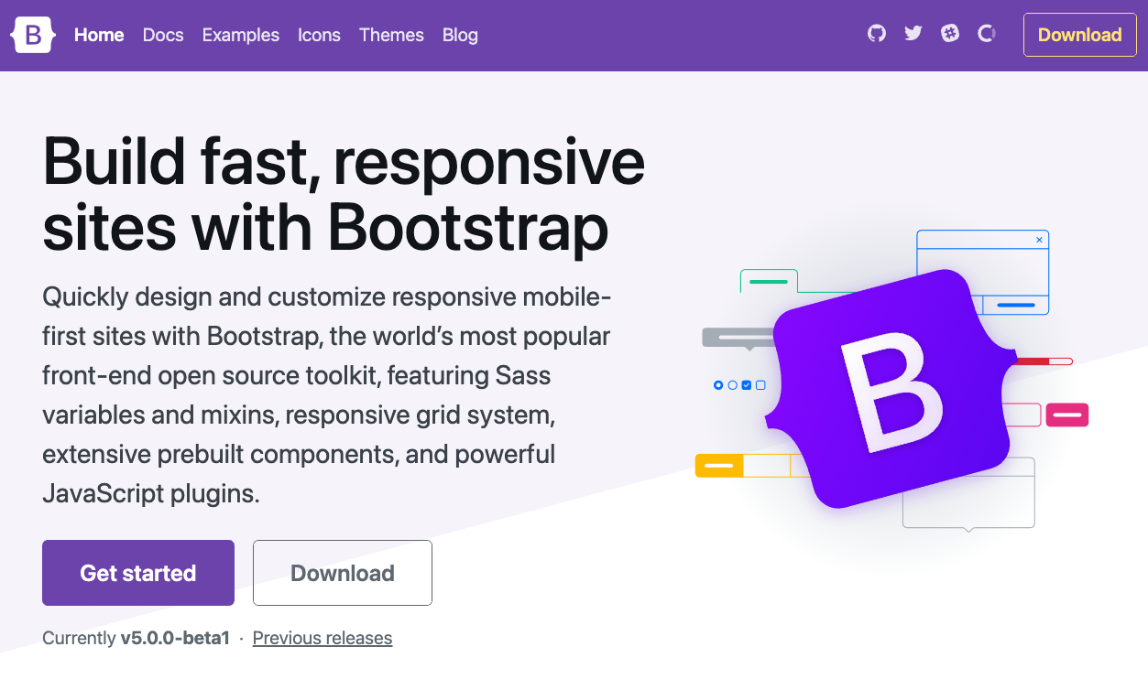
Bootstrap
Bootstrap is a free and open-source CSS framework directed at responsive, mobile-first front-end web development. It contains CSS- and JavaScript-based design templates for typography, forms, buttons, navigation, and other interface components.

Slide 16
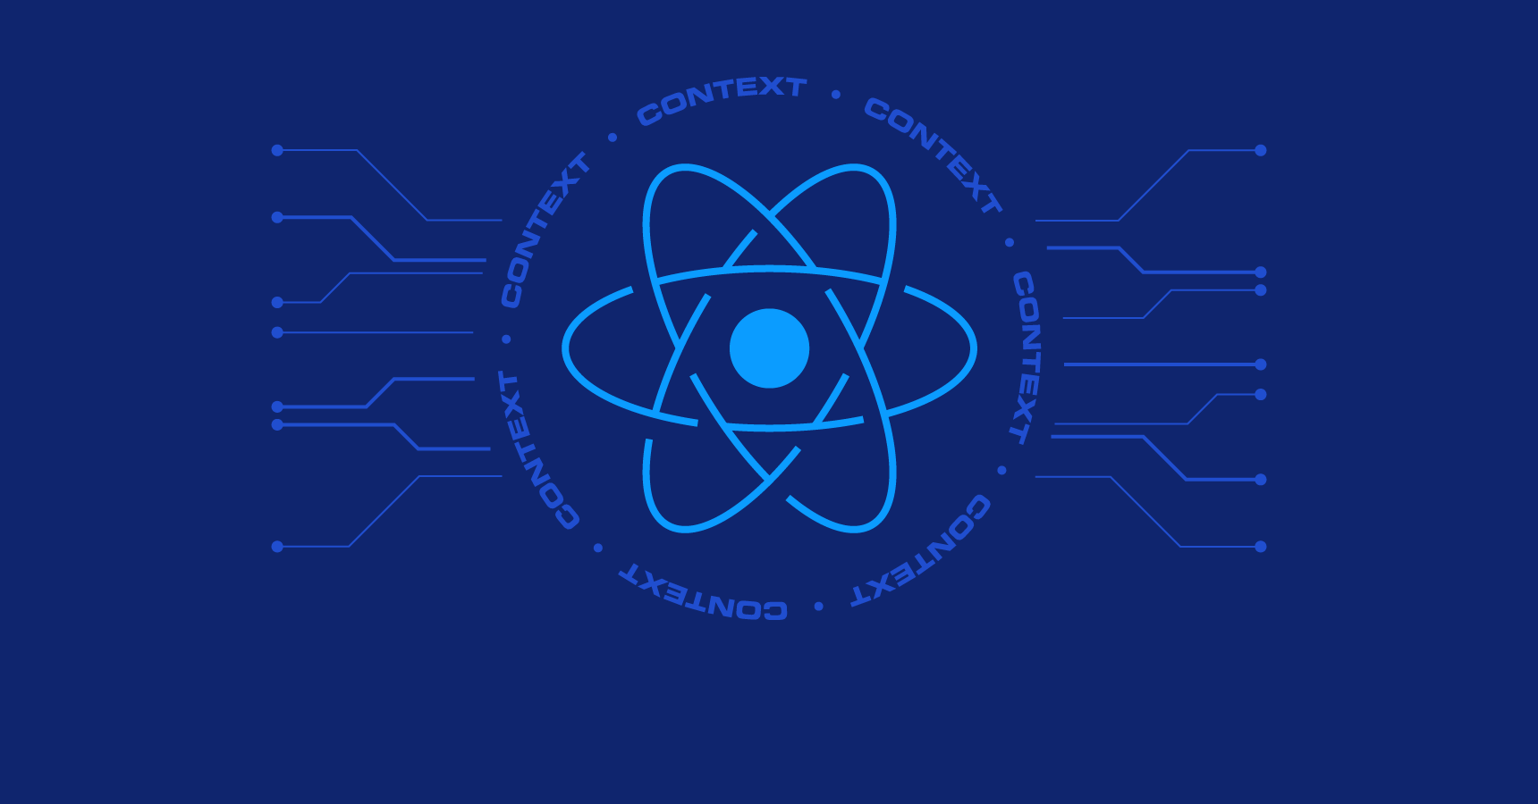
React
- React is an open-source, front end, javascript library for building user interfaces or ui components.

Slide 17
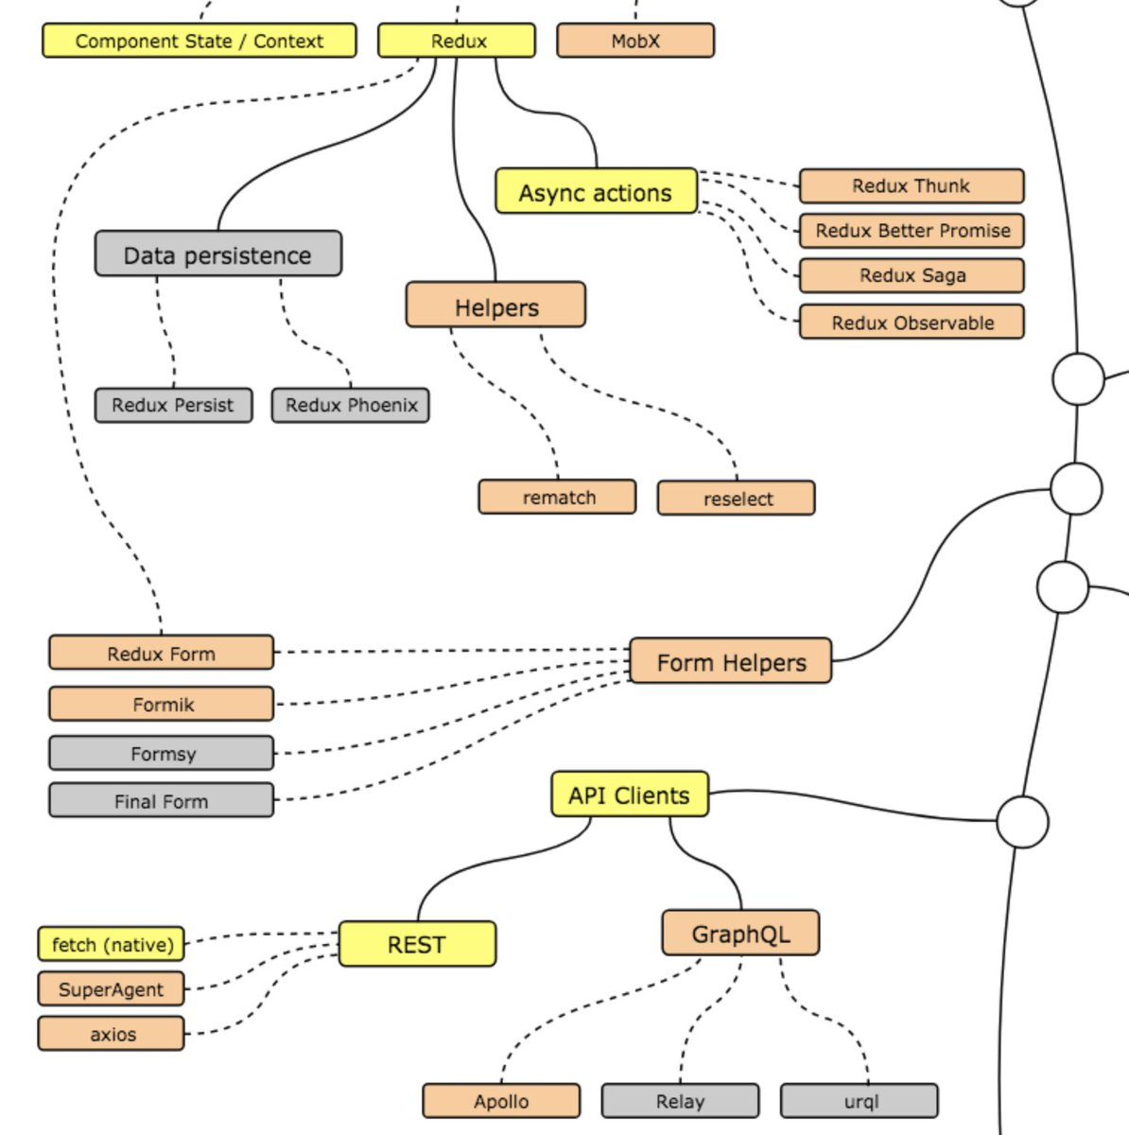
React
“The paths that you can take and the libraries that you would want to learn to become a react developer.”

Slide 18
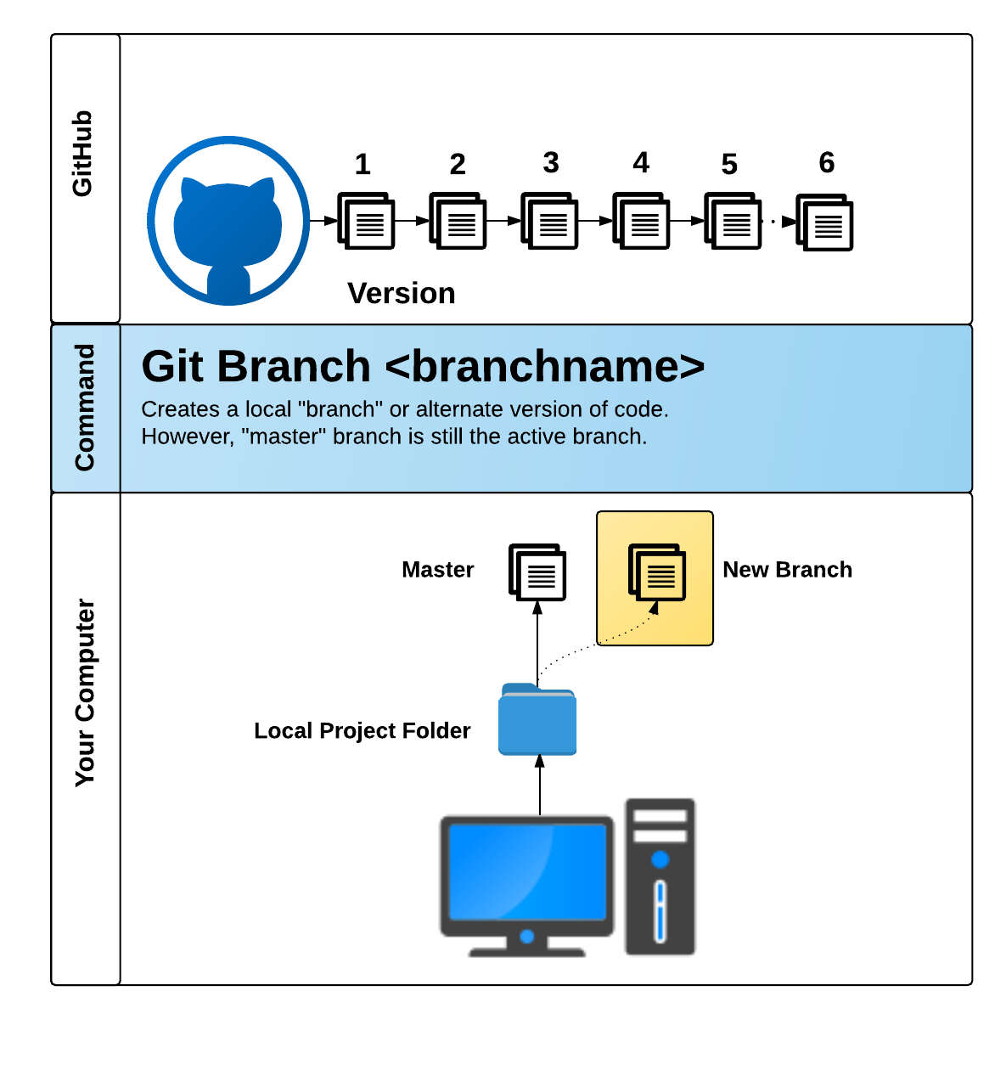
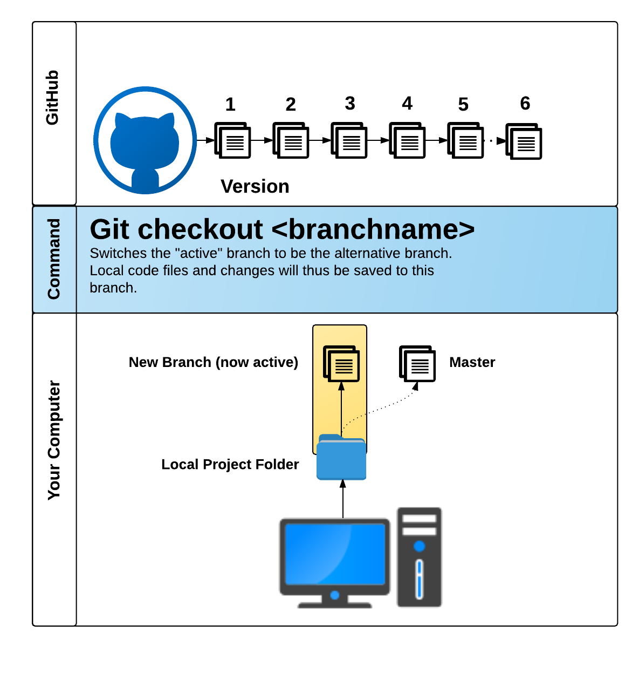
Github pull request
GitHub Pull Requests are a great way to “combine” code when multiple users are working on the same files.

Slide 19

Task at hand

Slide 20
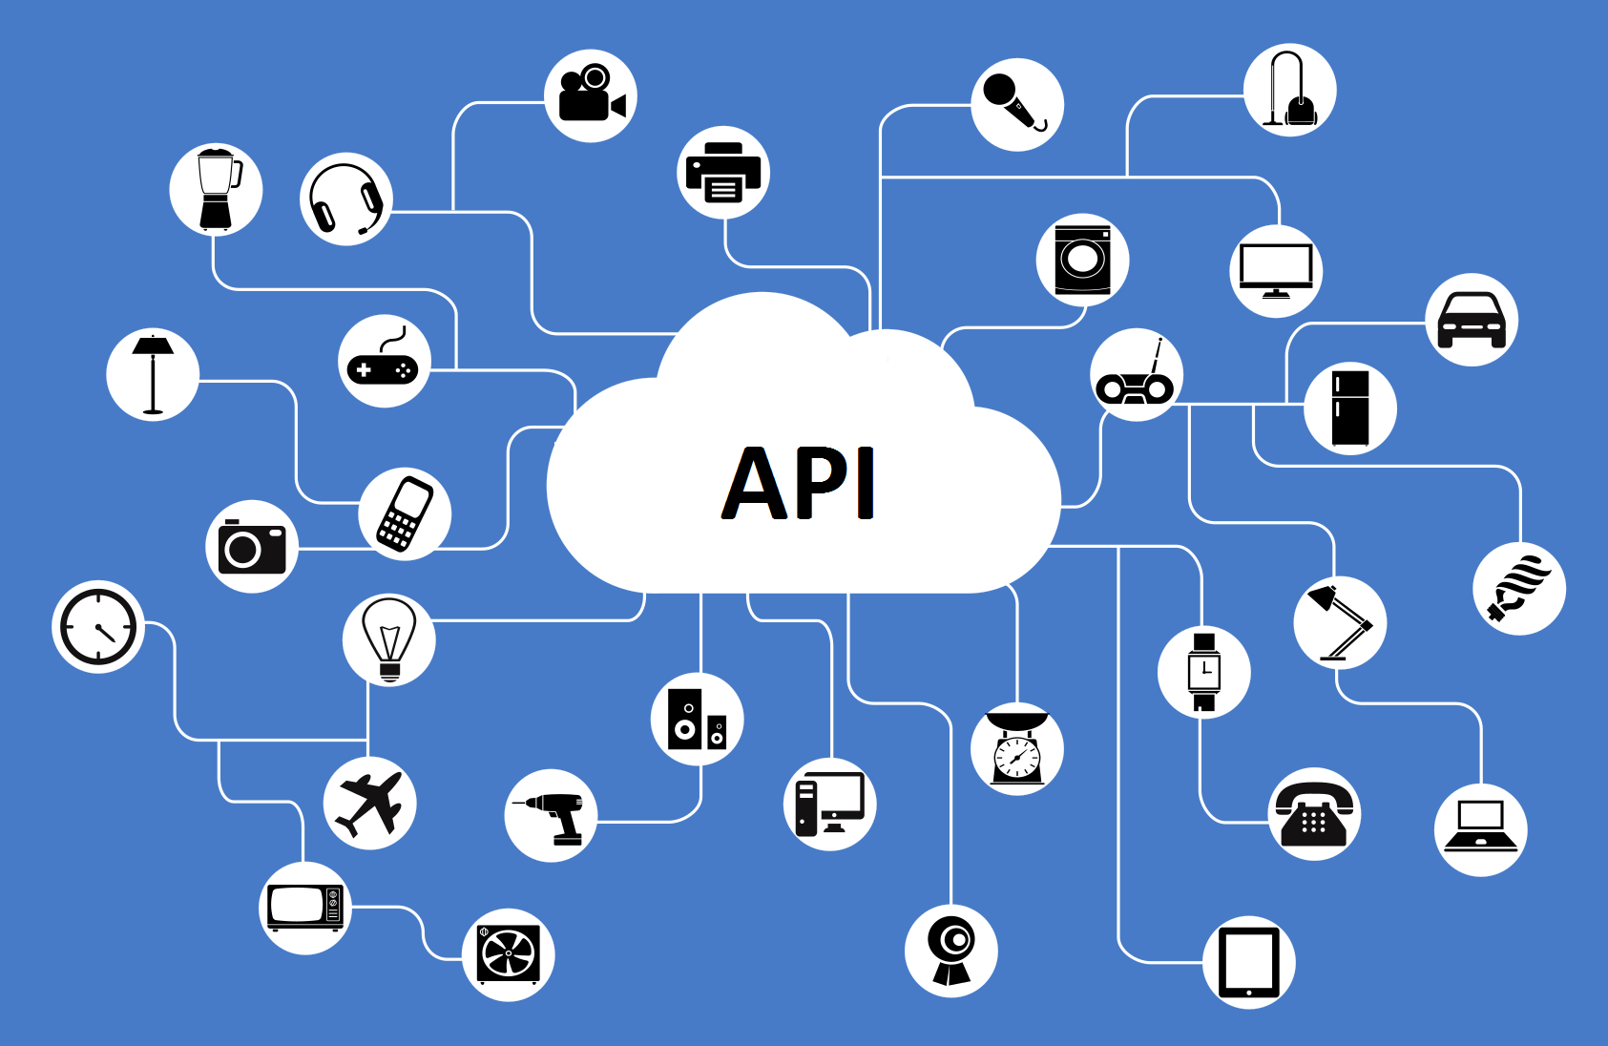
Find the perfect api
Stick to APIs that do all of the following:
Allows CORS (i.e. Doesn’t block you from using it on your own website)
Simple or no authentication (Authenticating can be messy)
JSON response returned
Well documented
Programmble Media, Media Optimizer, Dynamic Asset Mangement, & Integration

Slide 21
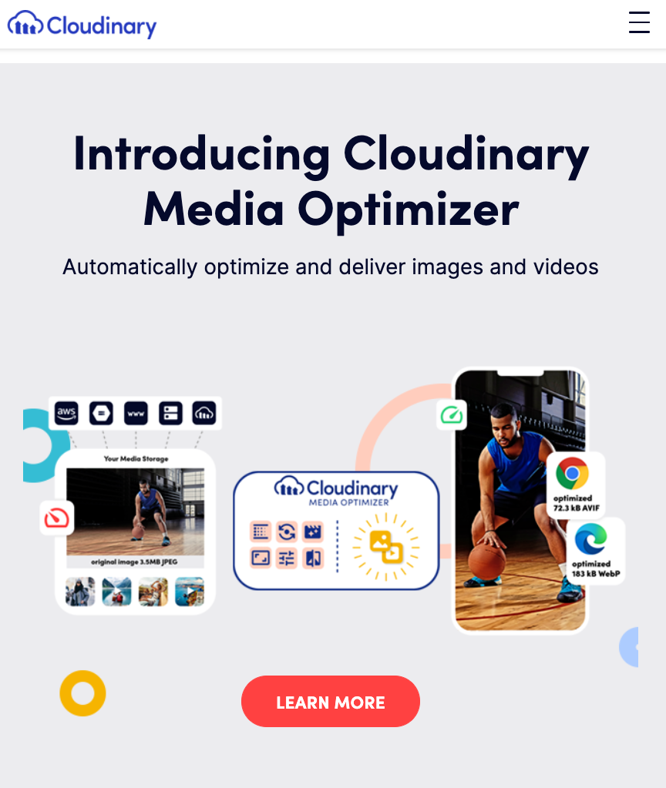
APi used
Cloudinary gives you the power to:
Handle image uploads effectively using a customizable widget.
Optimize images for web & mobile consumption using transformations
Perform admin operations including renaming, deleting, etc
Store & backup images/videos
Manipulate media files
Deliver media files

Slide 22

Design, concept, & functionality

Slide 23
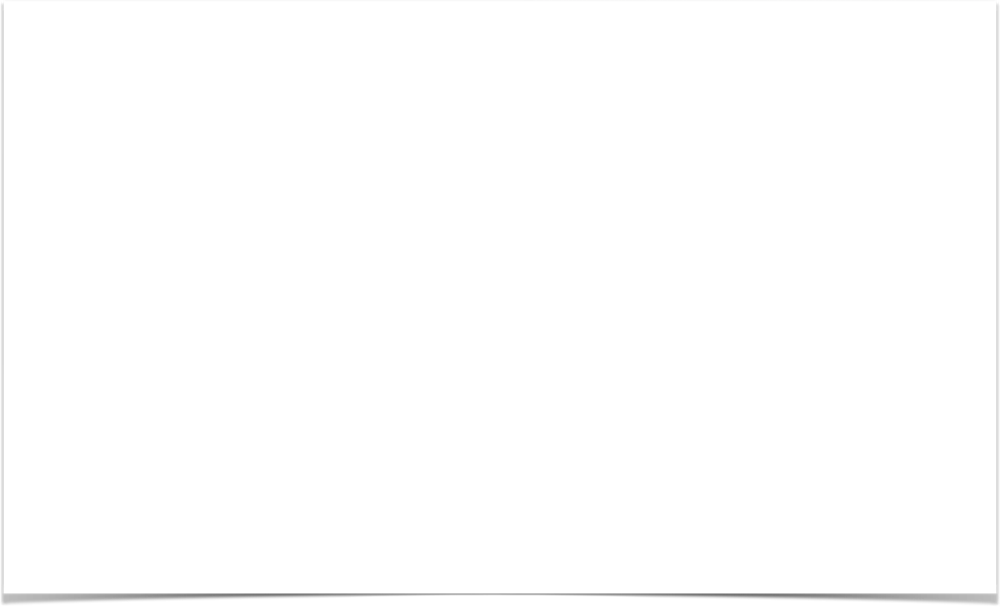

Concept
“Invest in your community”
Group brainstorm.
Find the right API to create a seamless database for our back-end.
Main focus was to have a simple UI that utilized React and had CRUD functionality.
Effortless and to the point.
Understanding as MERN developer what it takes to create an application.

Slide 24

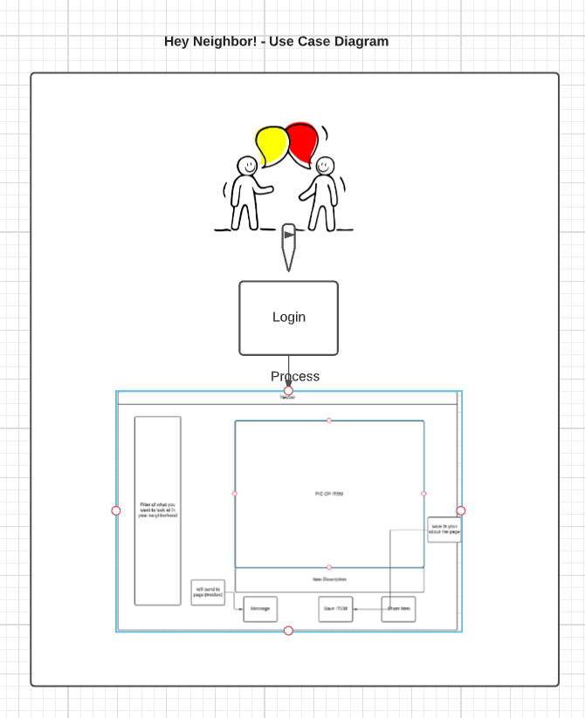
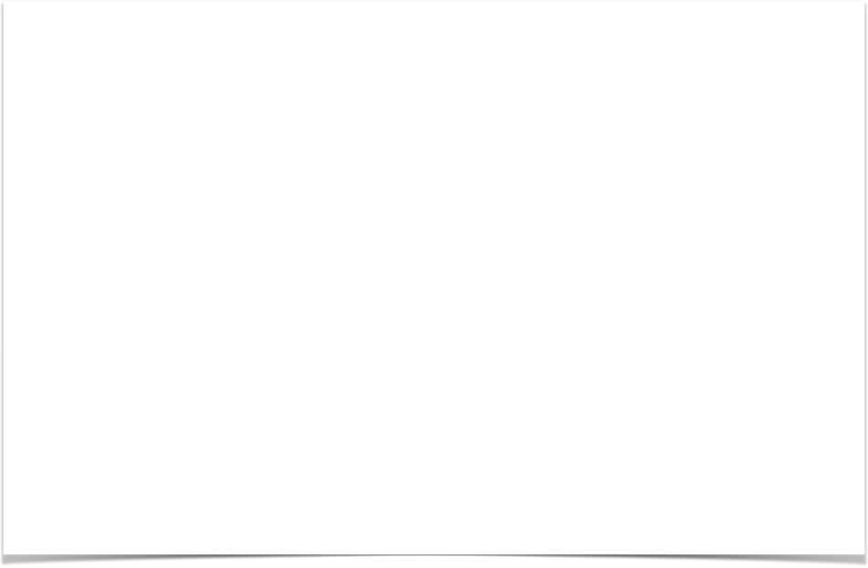
Design

Slide 25

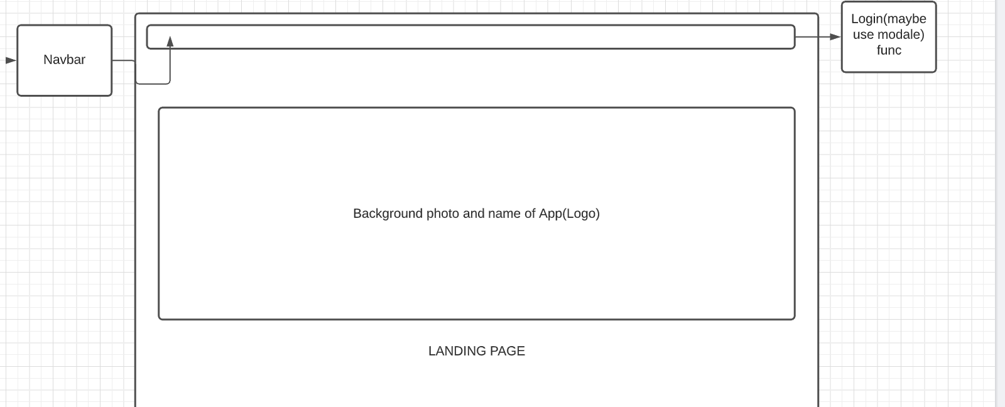
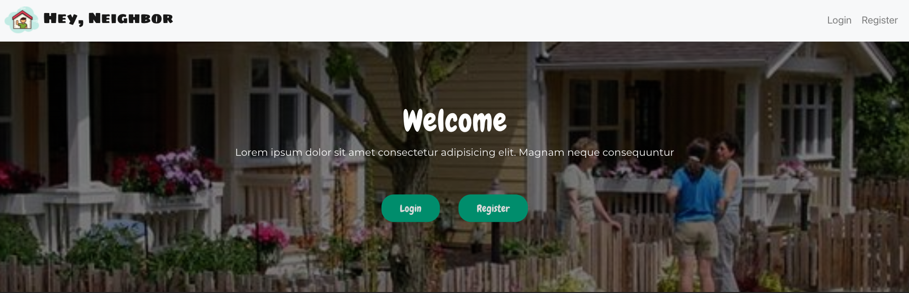
Design

Slide 26
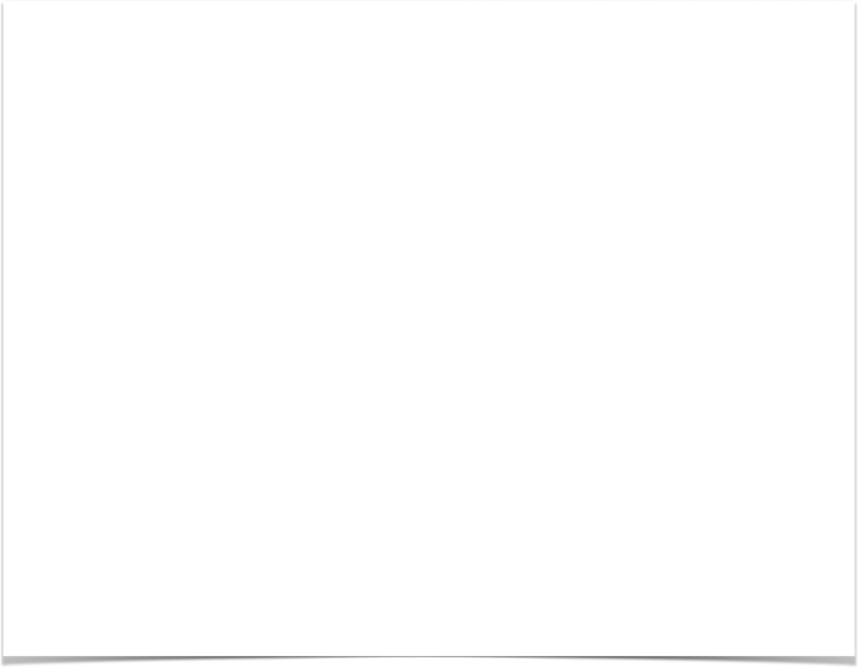
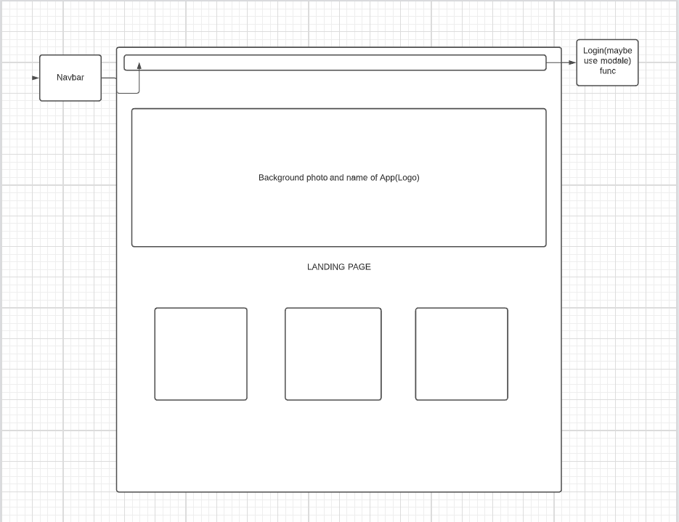
Functionality

Slide 27

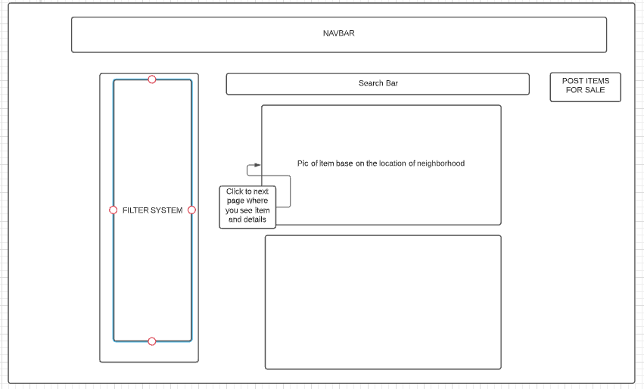
Functionality

Slide 28
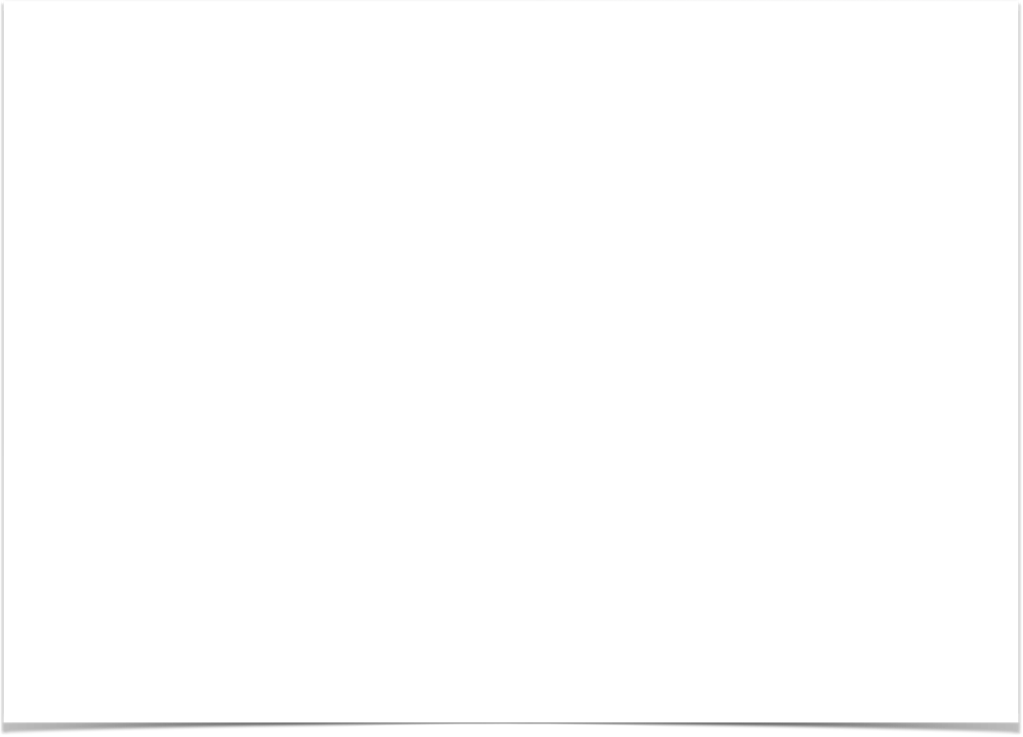
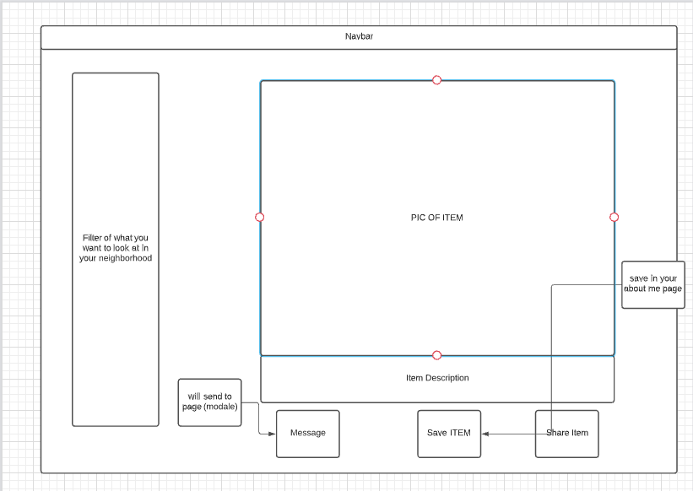
Functionality

Slide 29
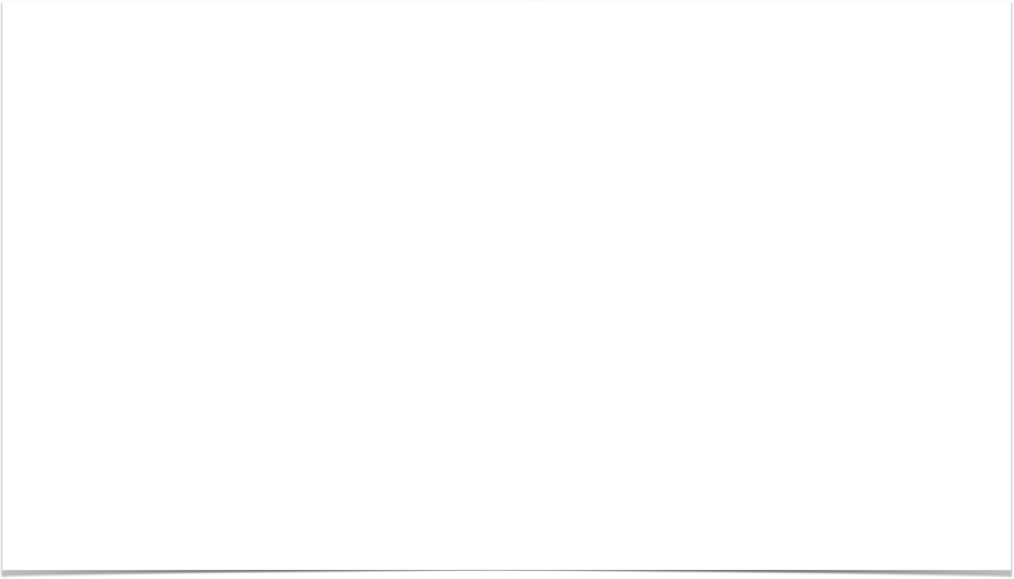
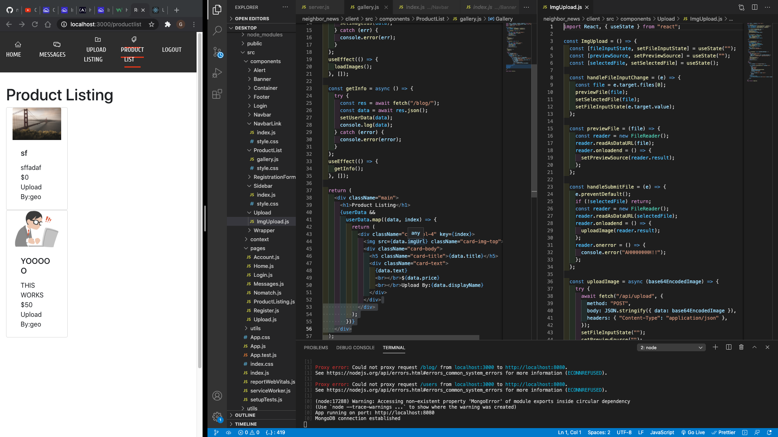
Functionality

Slide 30
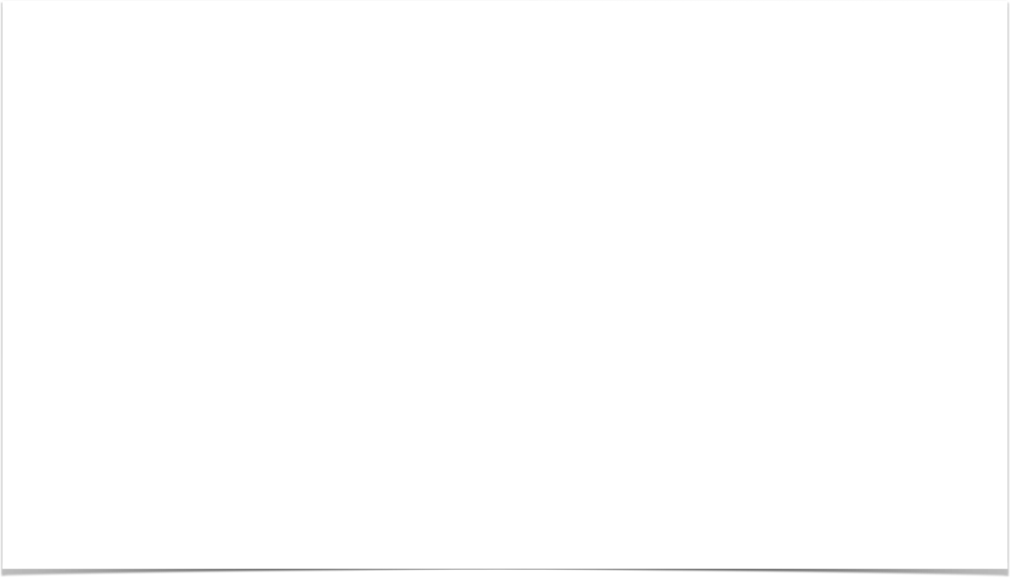
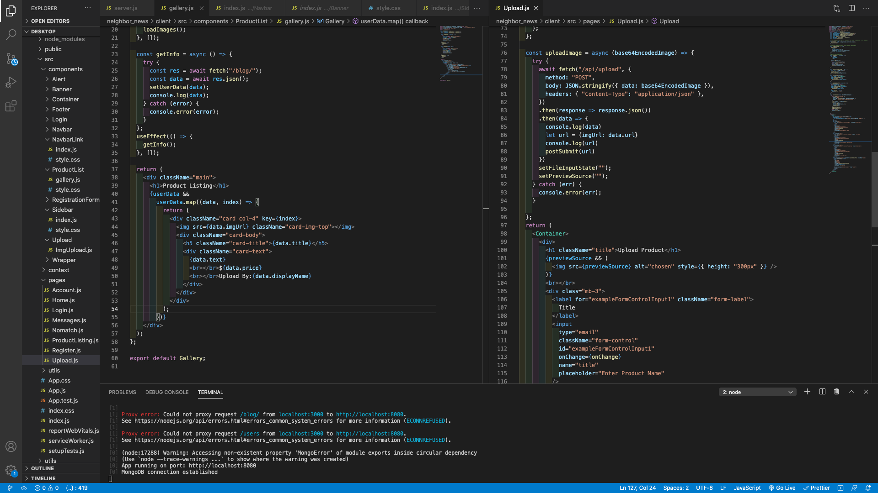
Functionality

Slide 31
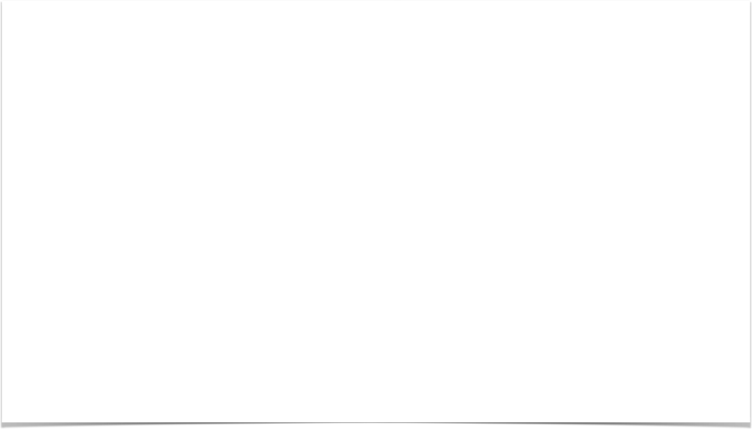
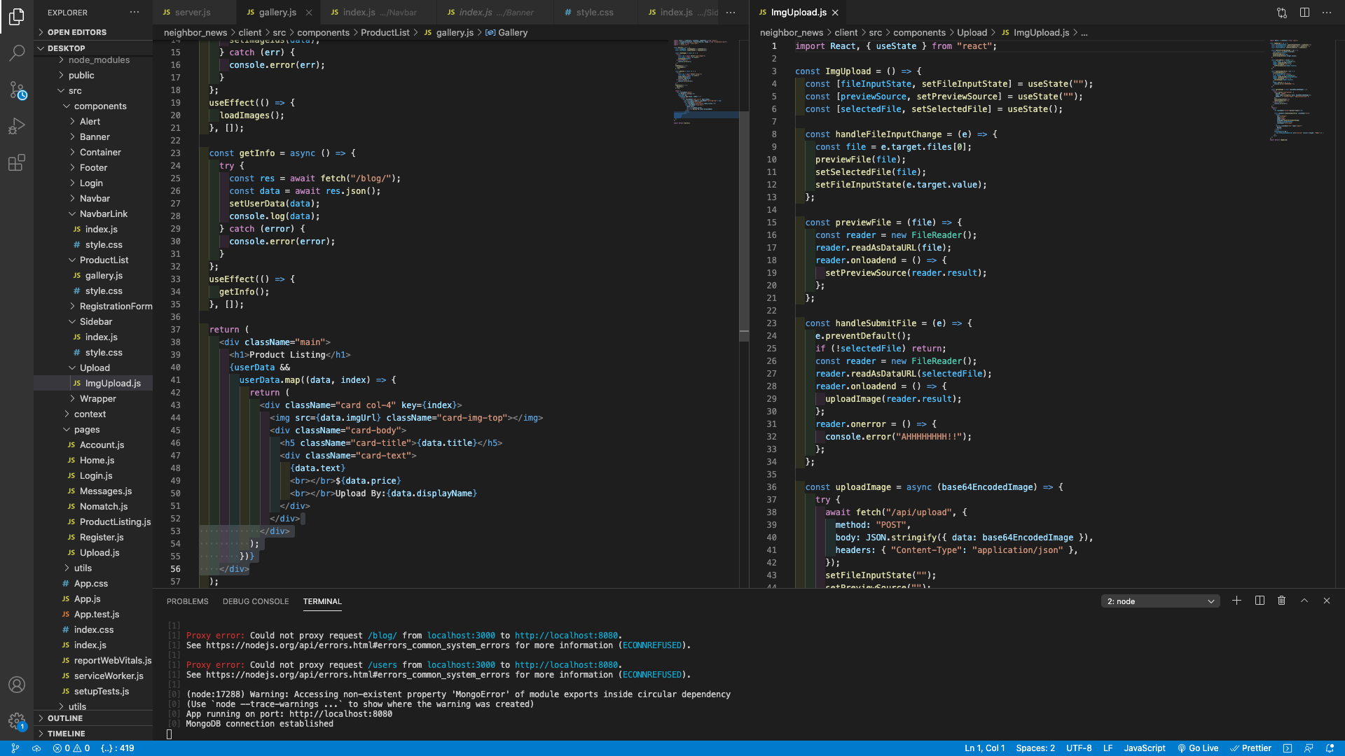
Functionality

Slide 32
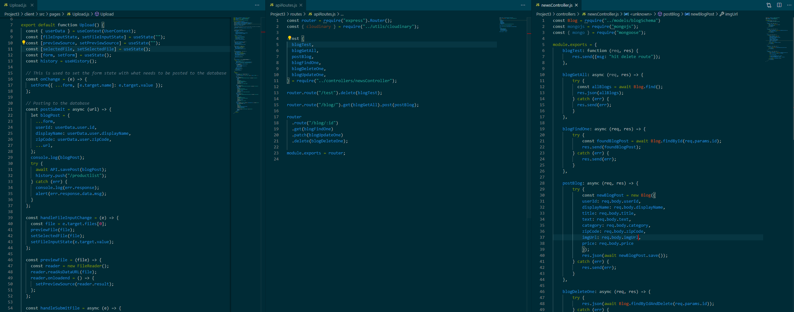
Functionality

Slide 33
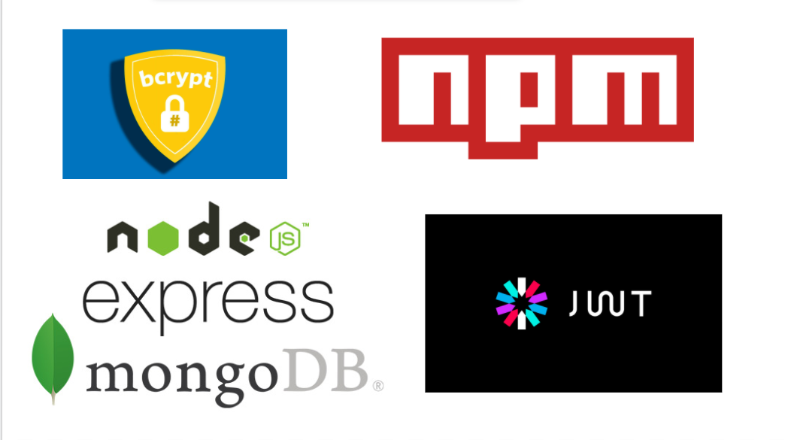
Functionality

Slide 34
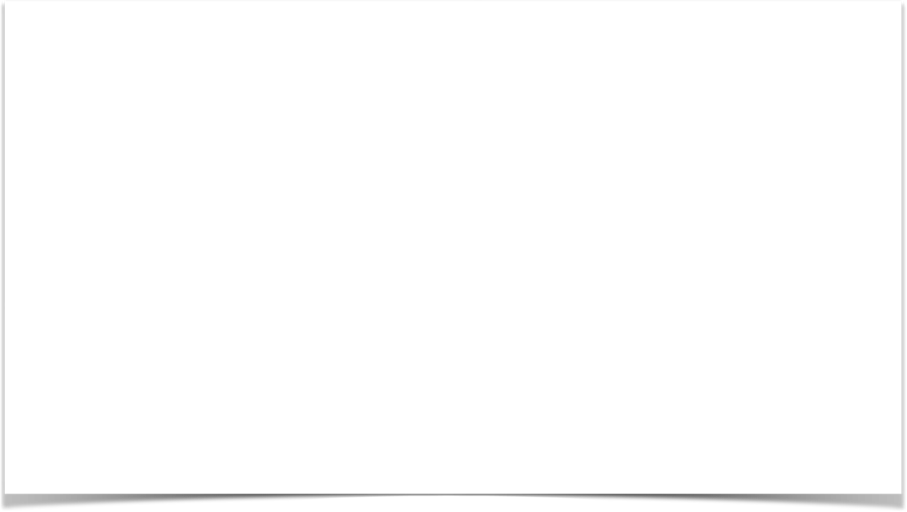
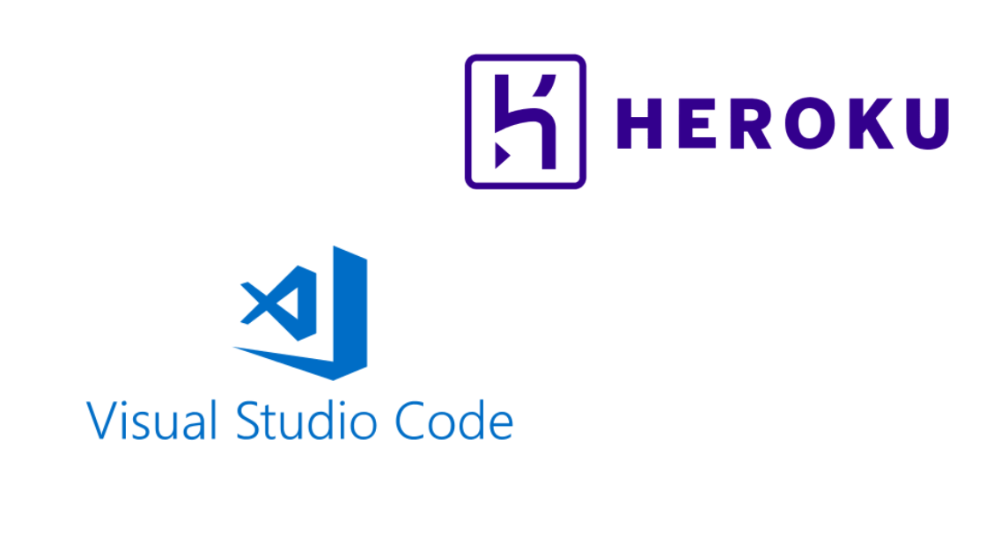
Functionality

Slide 35
Demo
https://hey-neighbors.herokuapp.com/

Slide 36
Future development

Slide 37
Future development
1. Debug some of our problems and flush out any other issues on the backend.
2. Add API to fetch google maps and find people in your surrounding area communicate with.
3. Add message function
4. Work on a native application for iOS/android.
5. Building and enhancing our UI.
Future Development

